Slide 1


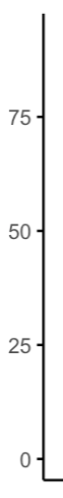
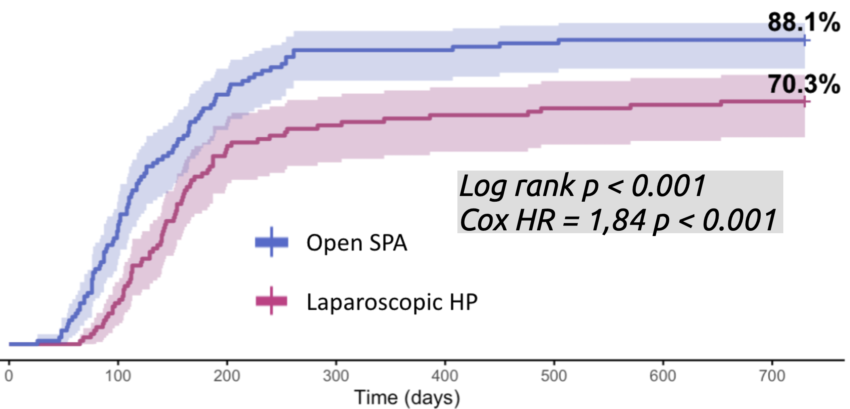
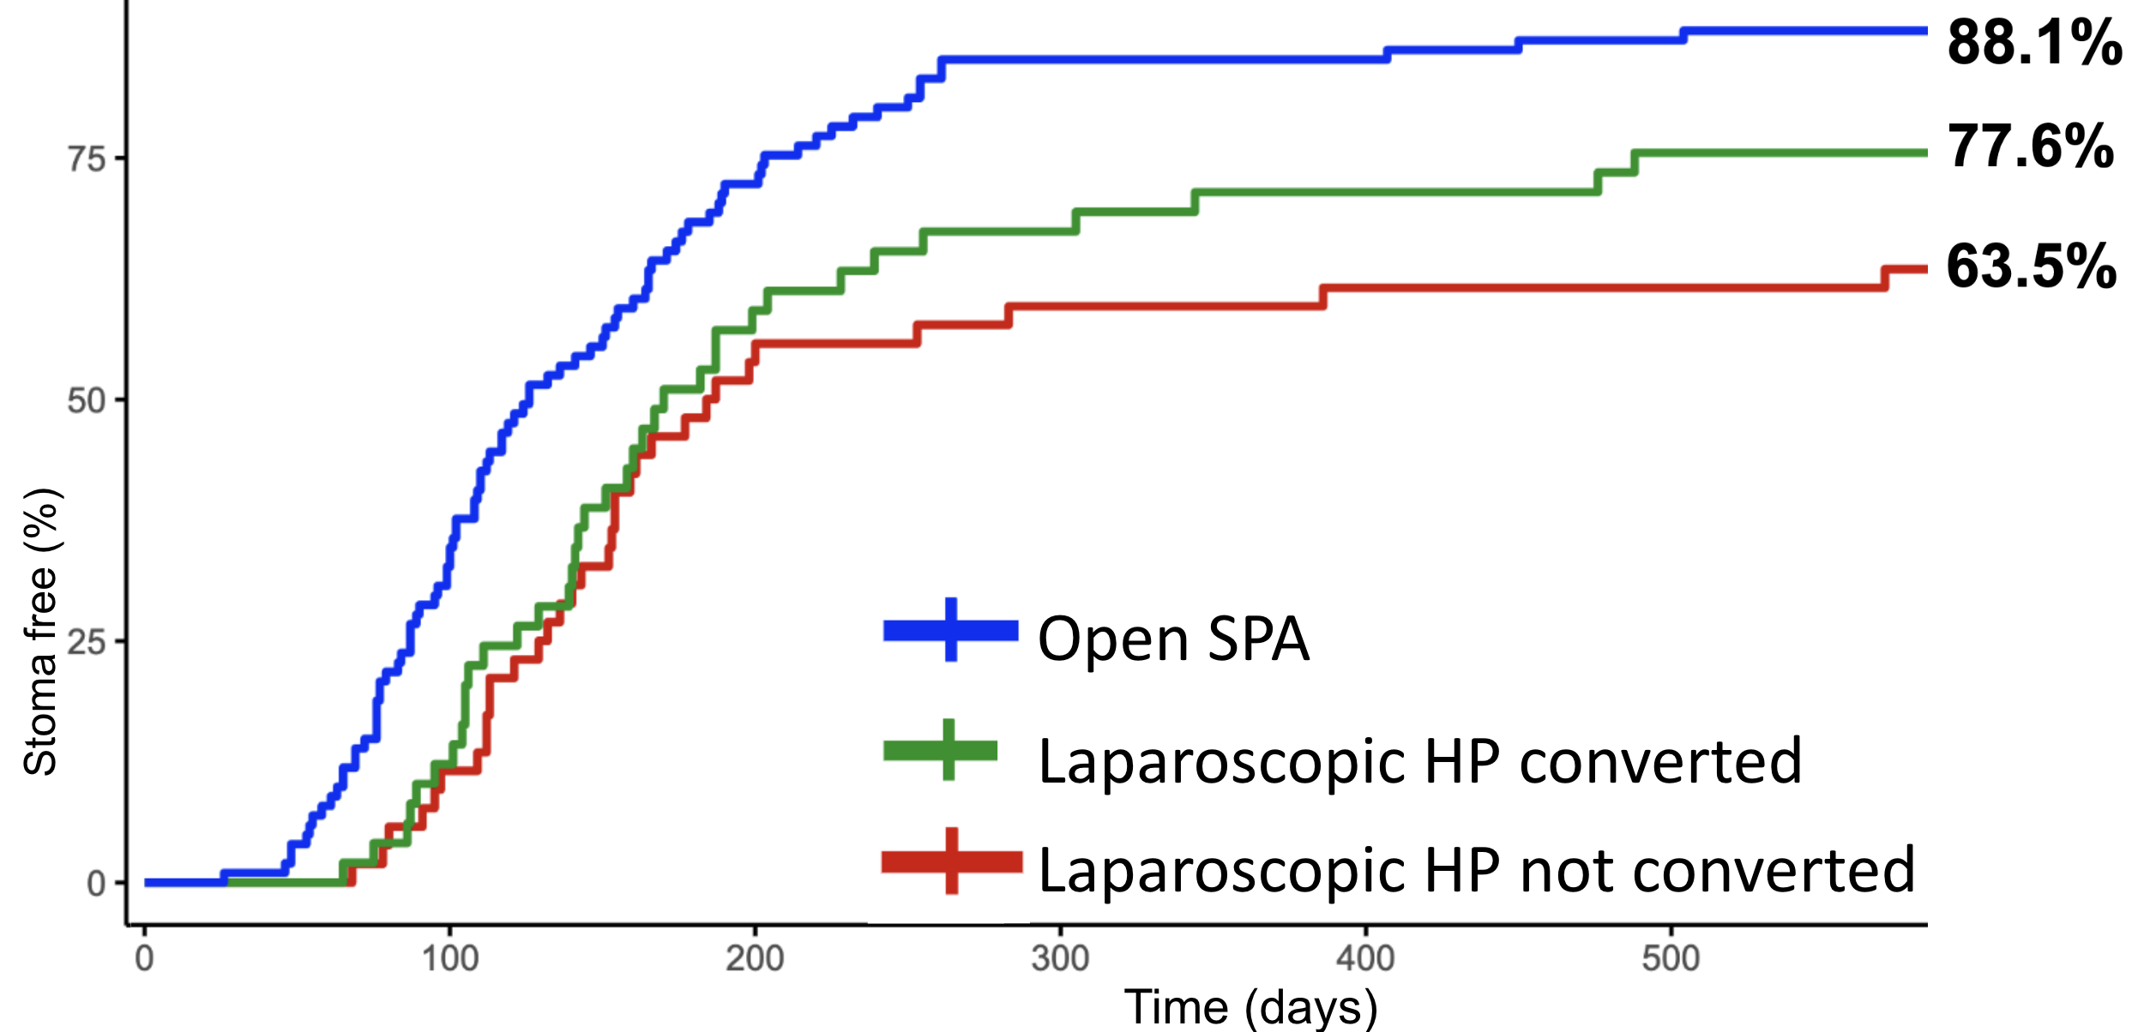

LAPAROSCOPIC HARTMANN :
A GOOD OPTION FOR ACUTE COLONIC DIVERTICULITIS WITH GENERALIZED PERITONITIS ?
A comparative matched cohort study using a national database
Thomas Husson¹, Charles Sabbagh², Antoine Cazelles¹, Gilles Manceau¹, Mehdi Karoui¹, Arnaud Alves³, Antoine Mariani¹
¹Hôpital Européen Georges Pompidou, Paris, France (Contact : thomas.husson@aphp.fr / antoine.mariani@aphp.fr)
²CHU d’Amiens, Amiens, France
³CHU de Caen, Caen, France
INTRODUCTION
Laparoscopy : well-established for elective / uncomplicated diverticulitis (Hinchey I-II)
Debated for generalized peritonitis from perforated diverticulitis (Hinchey III-IV)
OBJECTIVE
Evaluate laparoscopic Hartmann for generalized diverticular peritonitis
LAPAROSCOPIC HARTMANN (HP)
vs.
OPEN SIGMOIDECTOMY PRIMARY ANASTOMOSIS DIVERTING ILEOSTOMY (SPA)
Primary endpoint = Stoma-Free Survival
PATIENTS AND METHODS
National database of 6893 surgeries for diverticular disease (2010-2021)
Laparoscopic HP : n = 138
1:1 PROPENSITY SCORE MATCHING
Laparoscopic HP : n = 101
Open SPA : n = 146
Open SPA : n = 101
RESULTS
Postoperative outcomes
CONVERSION
MORBIDITY : no difference
50% in LHP group
 | Laparoscopic HP N=101 | Open SPA N=101 | p value
Mortality | 5 (5.0%) | 3 (3.0%) | 0.7
Dindo≥ 2 | 27 (27%) | 26 (26%) | >0.9
LENGTH OF STAY
12d vs 10d ; NS
INCISIONAL HERNIA
19% vs 21% ; p = 0.9
Stoma-Free Survival
Open SPA vs Laparoscopic HP
Impact of conversion
p = 0,01
NS
Log rank p < 0.001
Cox HR = 1,84 p < 0.001
CONCLUSION
Despite similar perioperative outcomes, Laparoscopic Hartmann leads to decreased stoma-free survival than Open Sigmoïdectomy with Primary Anastomosis and Ileostomy
Open sigmoidectomy with primary anastomosis and protective ileostomy remains the reference procedure for Hinchey III–IV diverticular peritonitis

